Slide 1
Owlbox Applications
Prem Kurumpanai

Slide 2
Potential Applications
Internal
Retrofit Blind-Spot monitoring to older vehicles
Average Speed of Traffic
Lane Change Warning
Traffic Signal Status
External
Velocity-based Stop Sign
Speed Limit Signs

Slide 3
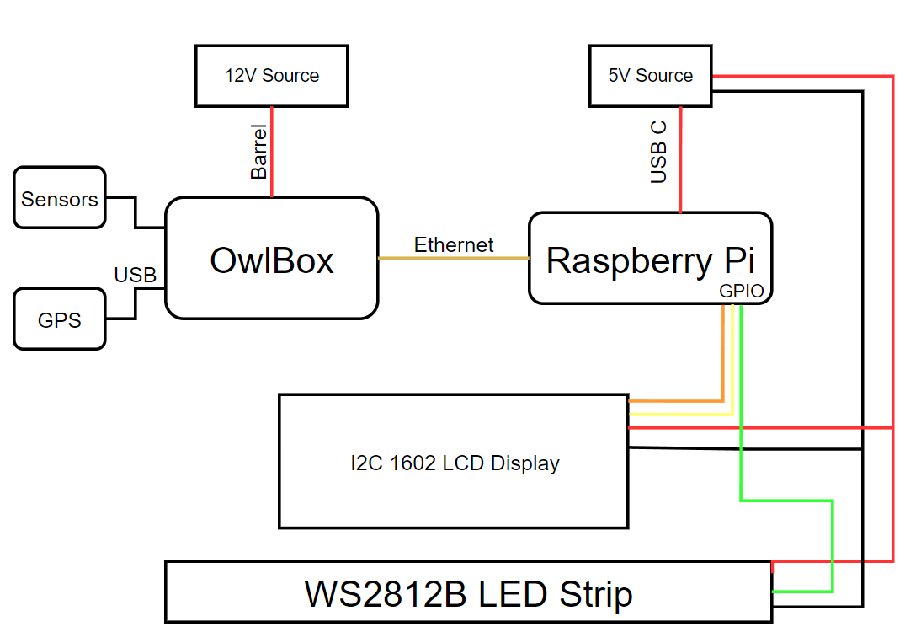
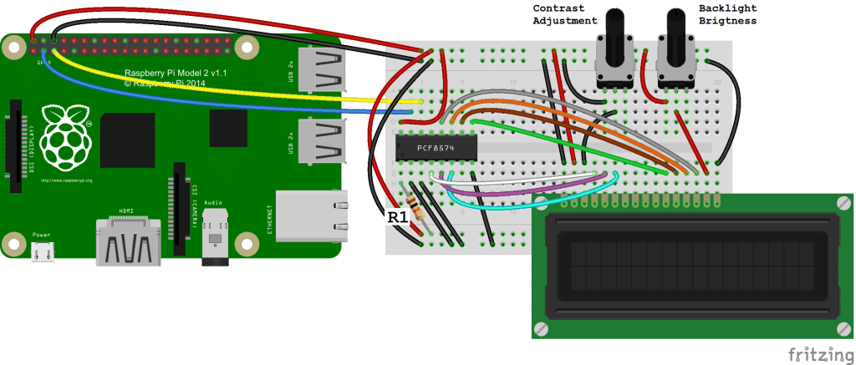
Internal: Schematic

Slide 4
Internal: Bill of Materials
Owlbox & 12V Power Supply
Raspberry Pi 3/4 (Model B) & 5V Power Supply
Ethernet Cable
I2C 1602 LCD Display
WS2812B LED Strip
Power Cable
SN74AHCT125 Level Converting Chip
2x Micro SD Card

Slide 5
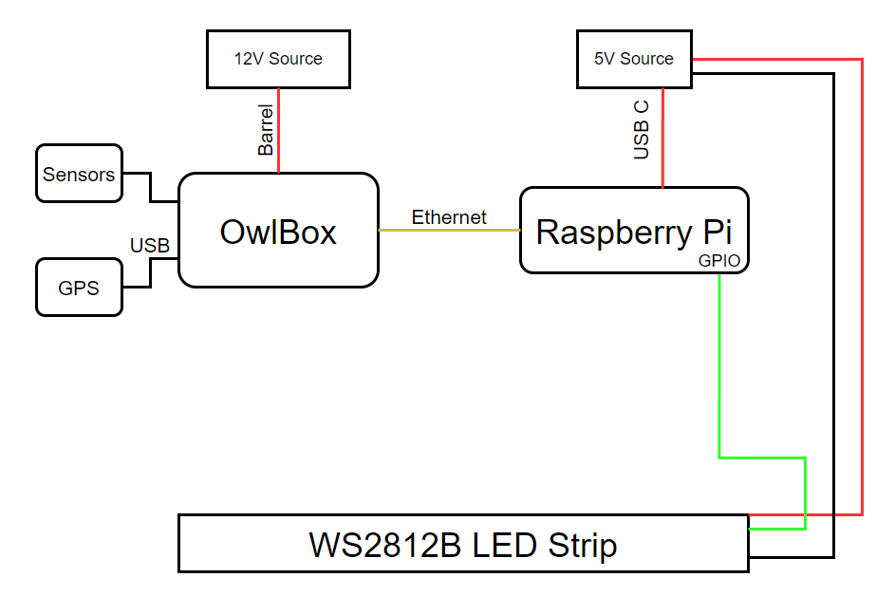
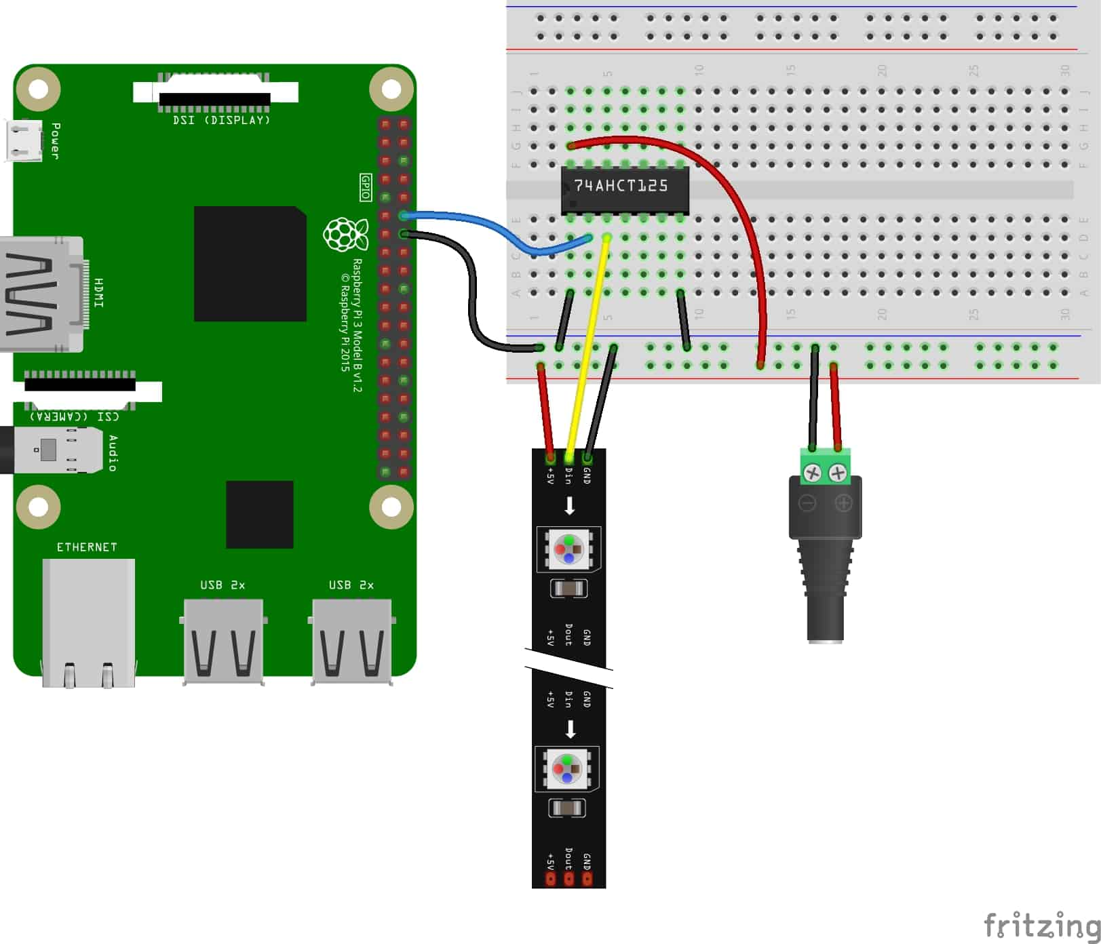
External: Schematic

Slide 6
External: Bill of Materials
Owlbox & 12V Power Supply
Raspberry Pi 3/4 (Model B) & 5V Power Supply
Ethernet Cable
WS2812B LED Strip & 5V Power Supply
SN74AHCT125 Level Converting Chip
2x Micro SD Card
Wiring/Breadboard
Enclosure

Slide 7
Libraries
Python
Socket
Rpi_ws281x
I2c-tools (SMBus)

